Slide 1


Slide 2

Unified University Management & Student Support Platform
Pre-Final Year Project Synopsis
Submitted by
Roll no.​ | Name ​
2301010289​ | Vaibhav Vaid​
2301010282​ | Adeela Azeez​
2301010300​ | Himani Tyagi​
2301010293​ | Ashutosh Singh​
2301010298​ | Satdev​
Faculty Mentor: Ms. Iflah Aijaz
Notes:
New Courses replaced with New Programmes

Slide 3

Project Overview
Universities usually manage academics, student support, and administrative work using
different systems or manual methods. Students often need to check notice boards,
emails, or visit offices personally to get information about attendance, exams, results, or
grievances. This makes the process slow and confusing for both students and staff.​
The Unified University Management & Student Support Platform is developed to solve
this problem by providing a single web-based system for all university-related activities. It
brings students, faculty, and administrators onto one platform where academic
information, requests, and communication can be managed easily.​
The system reduces manual work, improves transparency, and ensures faster
communication. By using role-based access, each user gets only the features relevant to
them, making the platform simple, secure, and efficient for daily university operations.​
Notes:
New Courses replaced with New Programmes

Slide 4
About the Problem
Despite being vital to overall wellbeing, mental health is frequently disregarded because of hectic schedules, a lack of knowledge, or the shame associated with emotional difficulties. Mood monitoring has become a popular tool for tracking feelings, spotting trends, and enhancing mental health. A computer tool called a mood tracking system is intended to assist people in recording their feelings, identifying patterns, and gaining important knowledge about their mental health.
The purpose of this project is to empower individuals to take control of their emotional well-being by providing an intuitive, data-driven, and user-friendly platform for mood tracking and journaling. By recognizing emotional patterns and triggers, users can make informed decisions to improve their mental health, reduce stress, and enhance their overall quality of life
Notes:
New Courses replaced with New Programmes

Slide 5
Problem Statement
In today’s fast-paced world, mental health and emotional well-being are frequently neglected which increases stress, anxiety, and depression. Peoples find it difficult to identify patterns in their moods and emotions, which makes it challenging to manage stress, determine triggers, and seek timely interventions.
A mood tracker and journaling website can help in tracking the effectiveness of interventions, whether they're lifestyle changes, therapy, or medication. It provides a way to see if certain activities or treatments positively impact your mood over time.
Notes:
New Courses replaced with New Programmes

Slide 6
Objectives
To design and develop a scalable mood tracking website
To integrate AI-driven analytics and data visualization
To implement an intuitive and user-friendly interface
To enhance user engagement through interactive elements
To ensure data privacy and security
To conduct extensive testing and gather user feedback.
Notes:
New Courses replaced with New Programmes

Slide 7
Methodology, Tools, and Techniques
Requirement Analysis – Identify project goals, features, and user needs.
Planning – Define technology stack, architecture, and development roadmap.
UI/UX Design – Create wireframes and prototypes using Figma.
Front-end Development – Develop the user interface with React.js or Vue.js.
Back-end Development – Build the server-side logic using Node.js/Django/Flask.
Database Setup – Configure PostgreSQL or MongoDB for data storage.
AI Integration – Implement chatbot functionality with OpenAI API or Rasa.
Security Implementation – Integrate OAuth, SSL, and GDPR compliance.
Testing & Debugging – Conduct unit, integration, and security testing.
Deployment – Host on AWS, Firebase, or Vercel.
Maintenance & Updates – Monitor performance, fix bugs, and release updates.
Notes:
New Courses replaced with New Programmes

Slide 8
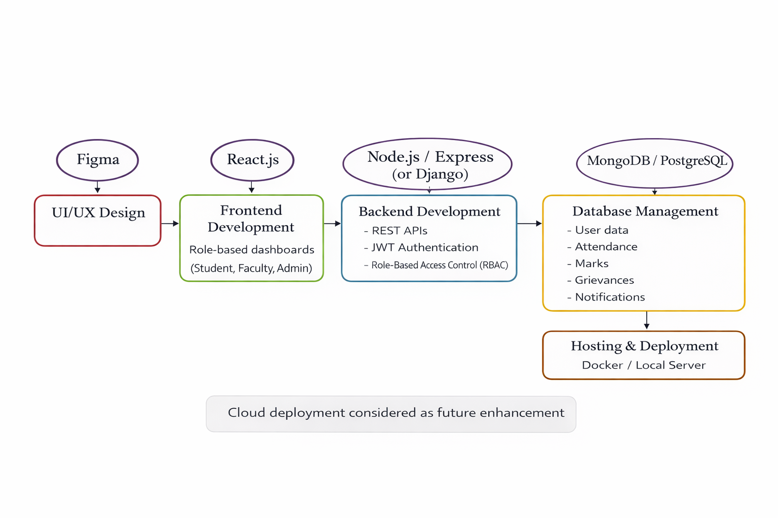
Methodology Flowchart
Notes:
New Courses replaced with New Programmes

Slide 9
Project Timeline
Requirement Analysis
Planning and Designing
Frontend Development
1 Feb 2026 to 7 Feb 2026
8 Feb 2026 to 14 Feb 2026
15 Feb 2026 to 7 March 2026
Testing & Validation
Database Setup & Integration
Backend Development
1 April 2026 to 15 April 2026
22 March 2026 to 31 March 2026
8 March 2026 to 21 March 2026
Hosting and Deployment
16 April 2026 to 30 April 2026
Notes:
New Courses replaced with New Programmes

Slide 10
Expected Results & Impact
Expected Results:
Improved Emotional Awareness & Self-Reflection
Better Stress & Anxiety Management
Increased Accessibility to Mental Health Support
Reduced Stigma Around Mental Health
Impacts:
Enhances accessibility and engagement in digital mental health solutions.
Contributes to the development of adaptive AI in mental wellness.
Increased Accessibility to mental health support
Expansion by integration with therapy & counseling Services
Notes:
New Courses replaced with New Programmes

Slide 11
References
Baikie, K. A., & Wilhelm, K. (2020). Emotional and physical health benefits of expressive writing. Advances in Psychiatric Treatment, 11(5), 338-346.
Bennion, M. R., Hardy, G., Moore, R. K., & Millings, A. (2020). E-therapies in England for mental health problems: An updated systematic review. Journal of Medical Internet Research, 22(7), e15641.
Fitzpatrick, K. K., Darcy, A., & Vierhile, M. (2017). Delivering cognitive behavior therapy to young adults with symptoms of depression and anxiety using a fully automated conversational agent. JMIR Mental Health, 4(2), e19.
Hollis, C., Falconer, C. J., Martin, J. L., Whittington, C., Stockton, S., Glazebrook, C., & Davies, E. B. (2018). Annual research review: Digital health interventions for children and young people with mental health problems–a systematic and meta-review. Journal of Child Psychology and Psychiatry, 59(4), 415-435.
Notes:
New Courses replaced with New Programmes

Slide 12
THANK YOU

